Slide 1
SOLUTION FOR POLLUTION CONTROL
BY
Rohit S
Ashwin H
Anirudha Tiwari

Slide 2
Current Scenario
Bangalore has approximately 10 million residents.
With growing population ,air and sound pollution is a serious issue these days. It is necessary to monitor air quality and keep it under control for a better future and healthy living for all.
Here we propose an air quality as well as sound pollution monitoring system that allows us to monitor and check live air quality as well as sound pollution in a particular areas through IOT.

Slide 3
Solution Approach
Our system uses air sensors to sense presence of harmful gases/compounds in the air and constantly transmit this data to microcontroller.
Also, this system keeps measuring sound level and reports it to the online server over IOT.
The sensors interact with microcontroller which processes this data and transmits it over internet.
This allows authorities to monitor air pollution in different areas and take action against it.
Also, authorities can keep a watch on the noise pollution near schools, hospitals and no honking areas, and if system detects air quality and noise issues it alerts authorities so they can take measures to control the issue.

Slide 4
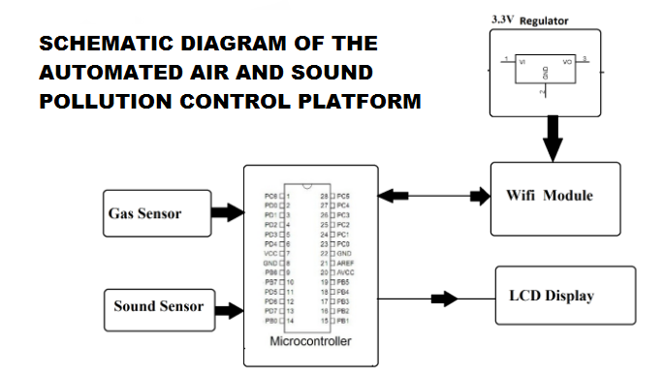

Slide 5
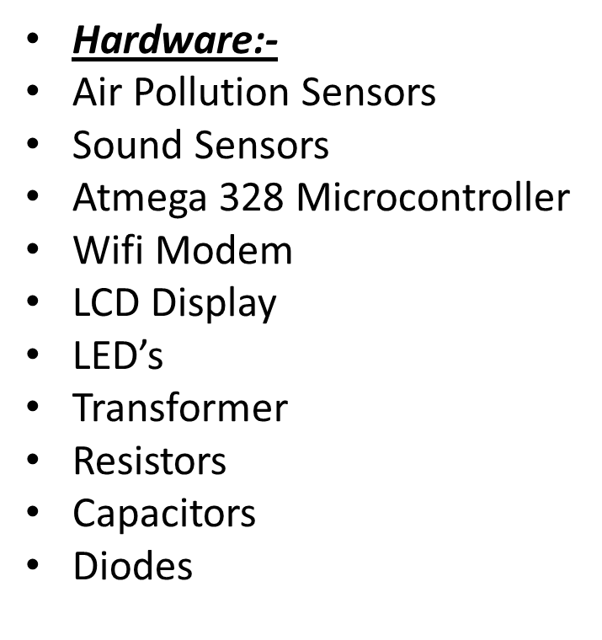
Hardware and Software Specifications
Software:-
Arduino Compiler
Microcontroller Programming Language: Embedded C
IOTGecko

Slide 6
THANK YOU

